Slide 1
Non deterministic Finite Automata

Slide 2
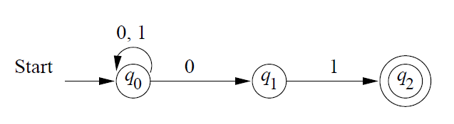
NFA
L={w|wϵ{0,1}*, w should end with 01}

Slide 3
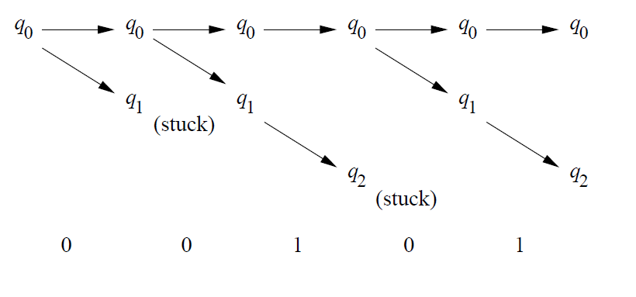
NFA Process
For the input 00101,

Slide 4
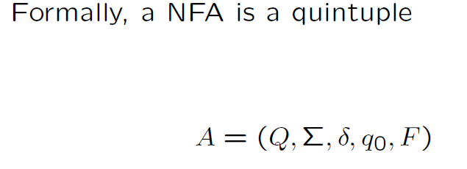
NFA Definition

Slide 5
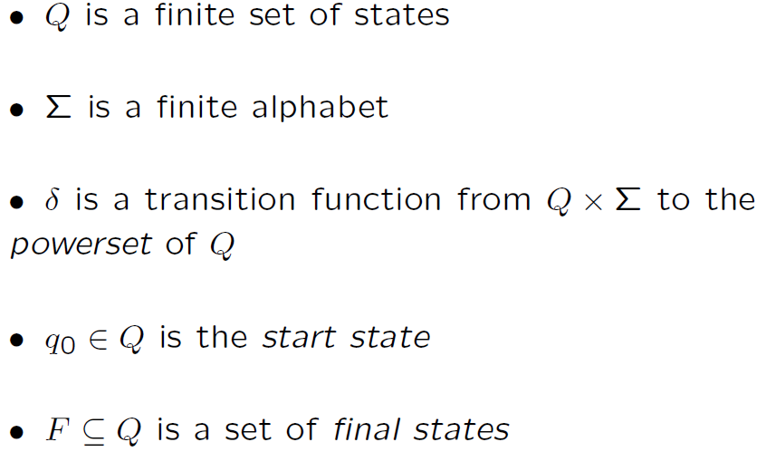

Slide 6
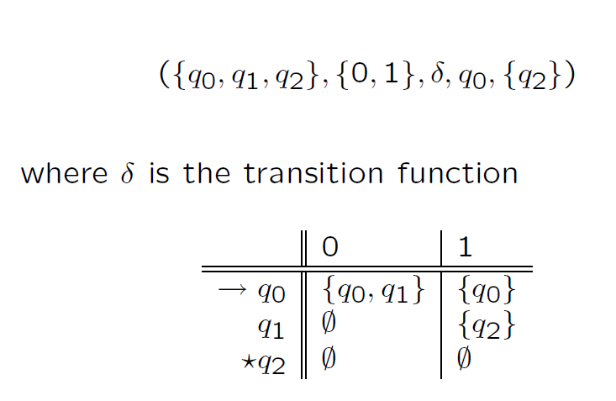
Transition Table for L={w|wϵ{0,1}*, w should end with 01}

Slide 7
Practice Question to construct NFA
A student from VIT Chennai wants to go to Central Railway station. There are different means to travel to central station from VIT. Student can go by car, auto, bus and electric train. E.g. Student can go by bus till Tambaram then by train to till park-station, then by walk to central. Design automata to represent this model. Consider all possible combinations of bus, car, auto, and train.

